Slide 1
CodeU
Bootcamp
Welcome to your 4th session!
The class will start shortly...
Reproduction and distribution of the presentation deck is prohibited

Slide 2
Agenda for today’s class
Kahoot!
01
02
Homework Revision
To recap what was seen in the previous class!
Let’s revise last week’s homework!
Topic of the day:
03
04
Practice time!
Learn to use code like a pro!
Practice problem
Introduction to conditionals
Wrap-up
Conclusion
05
06
CodeU Robot
Summary of what we’ve learned today
homework and questions

Slide 3

Time for Kahoot!
Head over to Kahoot.it for a fun coding quiz!

Slide 4

Last Class Homework Correction
01
# Greet the user
name = input("What is your name?: ")
print(name)
print("Welcome "+ name + " to my calculator!")
# Addition of 2 numbers entered by the user
print("ADDITION")
x = input("First number: ")
y = input("Second number: ")
addition = int(x)+int(y)
print(addition)
# Subtraction of 2 numbers entered by the user
print("SUBTRACTION")
x = input("First number: ")
y = input("Second number: ")
subtraction = int(x)-int(y)
print(subtraction)
02
# Multiplication of 3 numbers entered by the user
print("MULTIPLICATION")
x = input("First number: ")
y = input("Second number: ")
z = input("Third number: ")
multiplication = int(x)*int(y)
print(multiplication)
# Thank you message
print("Thank you for using my Calculator!")

Slide 5
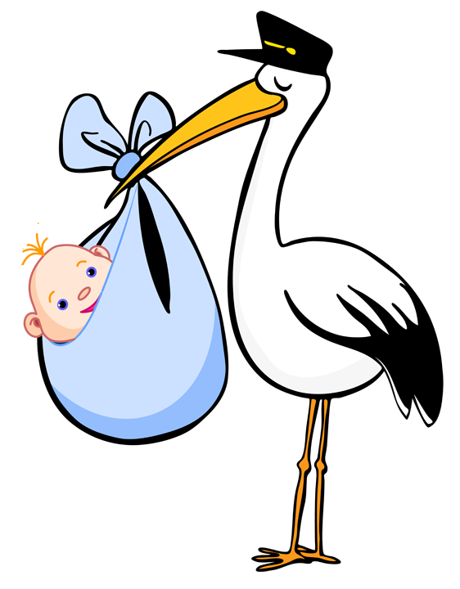
When were you born?
01
Exercise description
The goal of this exercise is to determine the year you born in using your current age and the current year.
Exercise steps
Create a variable for your age using the INPUT function
Create a second variable with the current year
Create a third variable where you will subtract the current year with your age.
Print() the result.

Slide 6
Introduction to Conditionals
Definition: Conditionals perform different actions depending on whether a condition is true or false. It is the way a computer reacts based on a decision.
Example: If a scary dog decides to chase you, you will run. If it doesn’t chase you, you will most likely just look at it. If there is no dog, there won’t be anything to do.
IF Statement
Elif Statement
Else Statement
It decides whether an action will be executed or not. If the condition is True, then it will be executed.
It verifies if another possible condition other than the one defined in If is True. Short for Else If.
Else statement catches any other possibility. It decides what to do if the condition is False.
Example
if name == “cat”:
print(“Miaow!”)
Example
elif name == “Cow”:
print(“MOOO!”)
Example
else:
print(“That is not an animal”)

Slide 7


Homework: ONE Quiz!
Homework Description
You must create a ONE question Quiz where the user must answer correctly or else, they lose the game! The question can be about any subject or topic you would like. You must let the user know if they answered correctly or incorrectly.
1
Create a variable using the input() function. This will log the user's answer to your question.
4
Create a 2nd condition ELSE that catches any other possible answer.
4.1
Print a message letting the user know they answered correctly!
2
Create the 1st condition IF, where the user's answer must be equal to the correct answer.
2.1
Print a message letting the user know they answered correctly!

Slide 8




Thank you!
Does anyone have any questions?
Next class: Class 5
Please contact us if you have any questions or if you want to notify us for anything.
Phone:
(438) 391-9106
Email:
hello@codeu.ca

